Slide 1
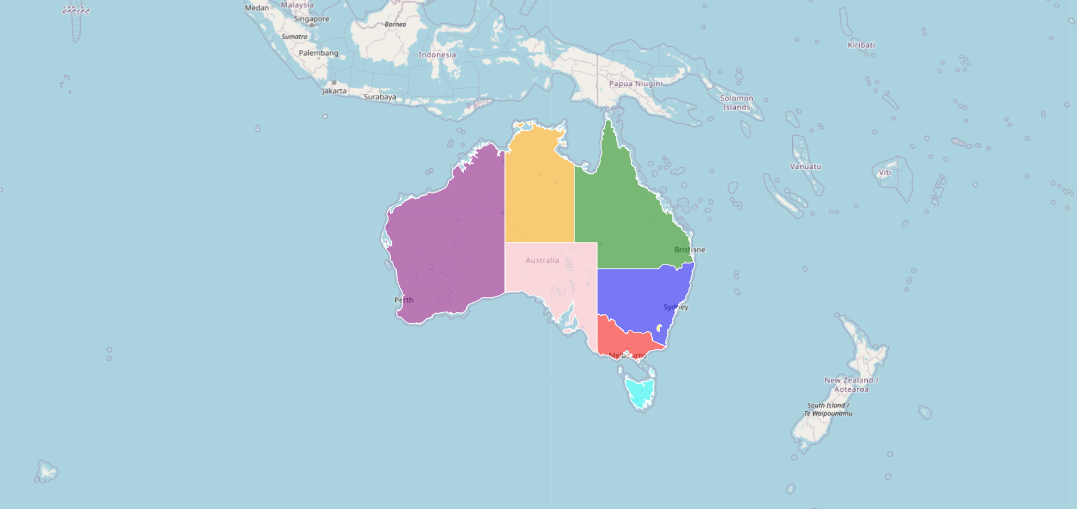
AUSTRALIAN COVID-19 DATA VISUALISATION & COMPARISON
Presented by:
Frank McKenzie-Stripp
Yan Shao
Carl Gonzales
Halley Ngoc Pham

Slide 2
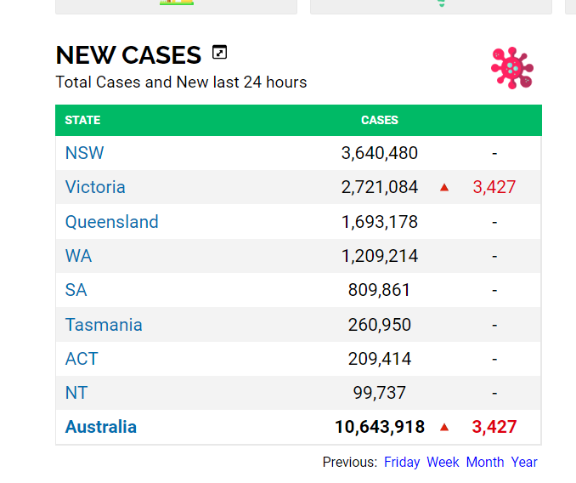
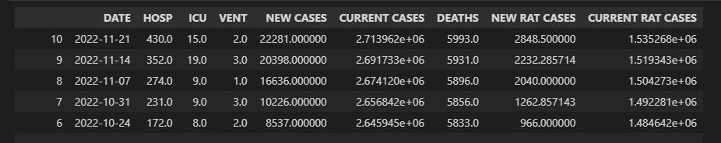
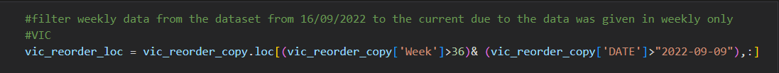
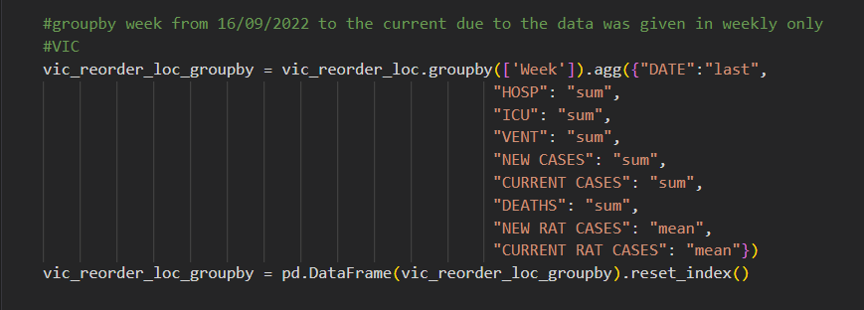
Web Scraping & Cleaning Process
Data source: https://covidlive.com.au
Web scraping
Retrieve database
Data cleaning
Rename columns, convert dates, groupby, aggregation

Slide 3
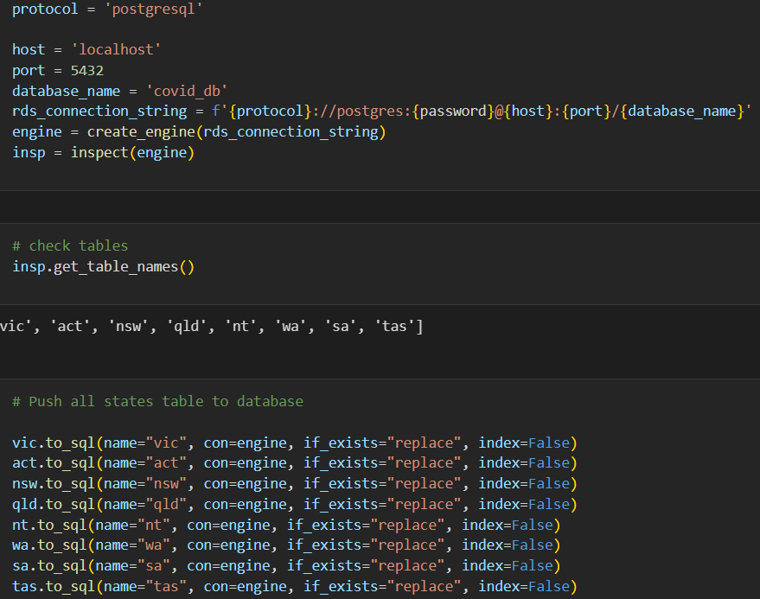
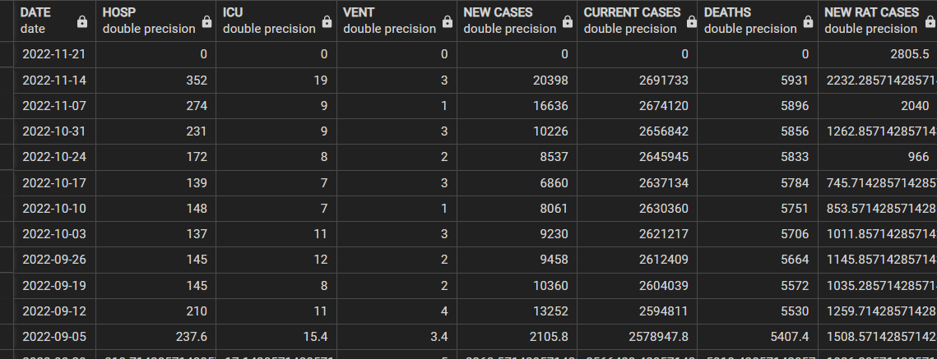
Connect Dataframe with SQL
We created 8 tables in PostgreSQL and then connect the DataFrame to our database
e.g. The Victoria table

Slide 4
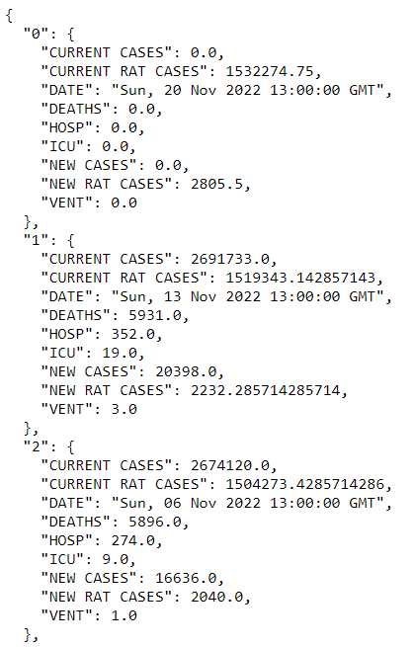
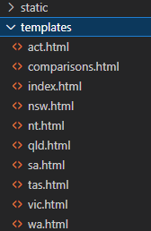
Flask & API
Set up Flask
Create routes
Accessing, requesting Data and convert SQL data to JSON
Generate HTMLs and link the homepage with all the routes
Retrieve data from SQL and convert to JSON format, and access with http://127.0.0.1:5000/{state}data
For example:http://127.0.0.1:5000/vicdata

Slide 5
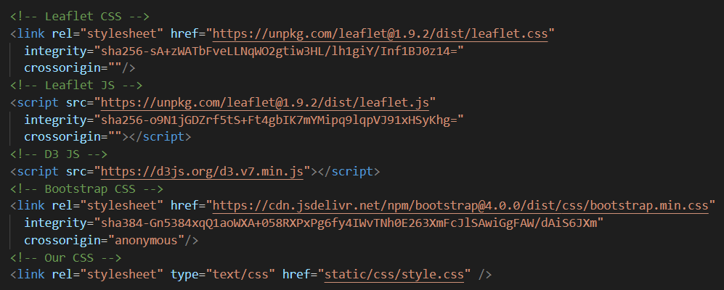
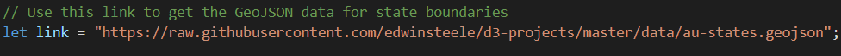
HTML & JS Libraries

Slide 6
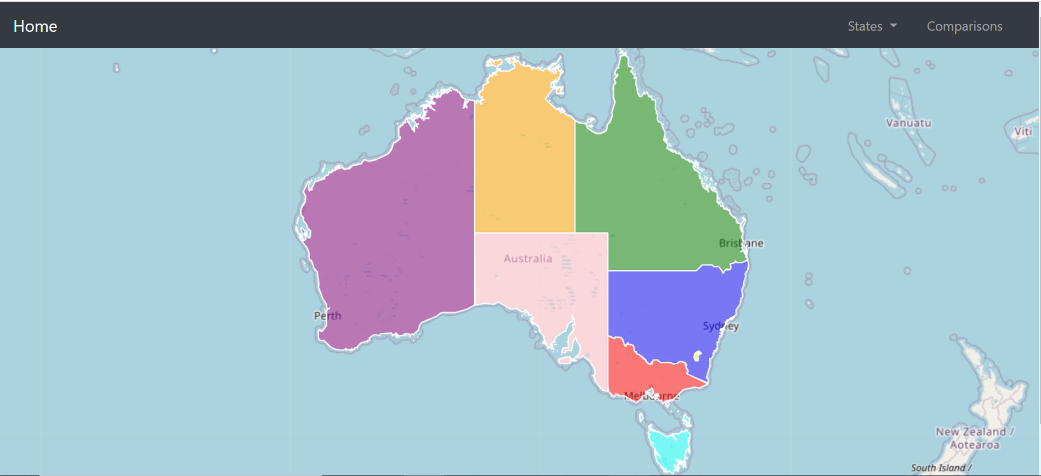
Home Page - index.html
The homepage - allows for navigation between all data visualisations for each state and the comparisons page

Slide 7

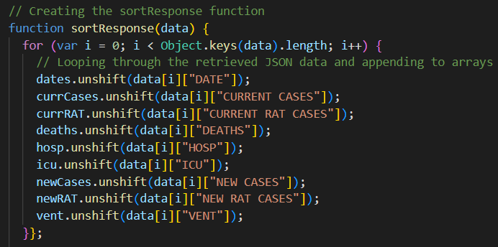
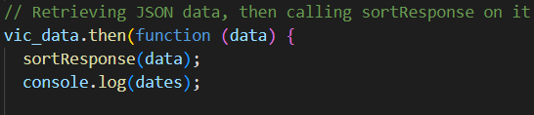
Creating the Charts

Slide 8
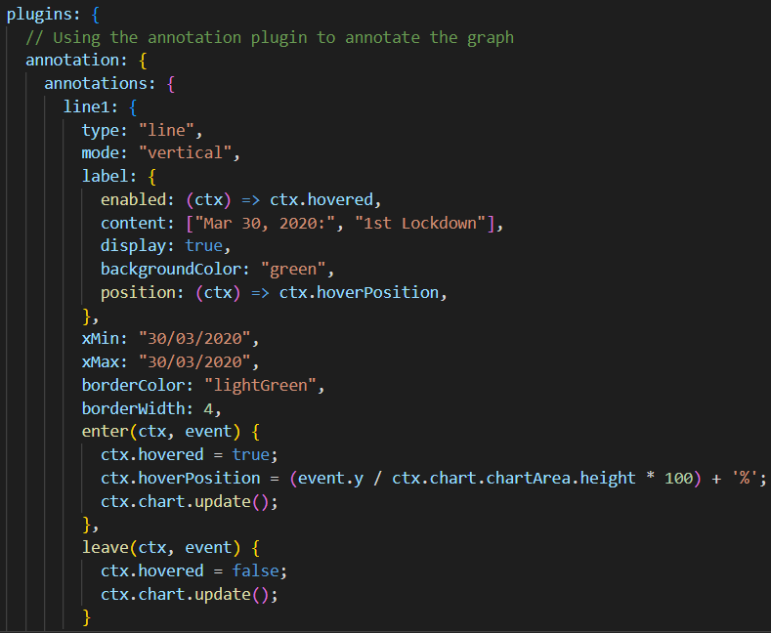
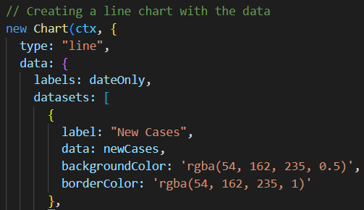
Creating the Charts - Line Charts

Slide 9
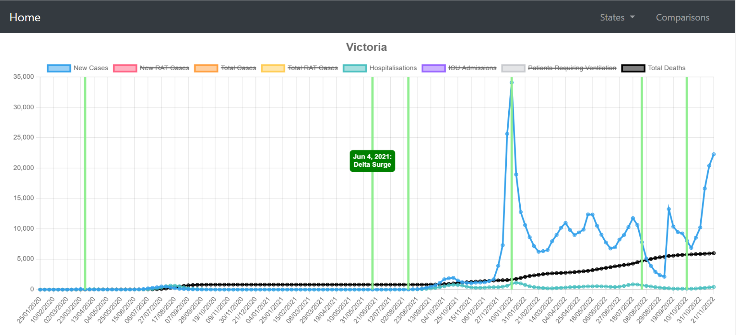
State Pages - Victoria

Slide 10
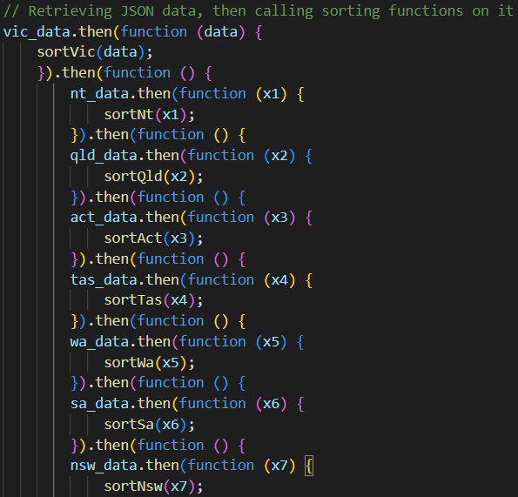
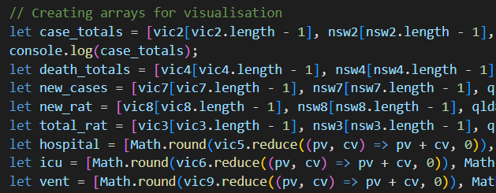
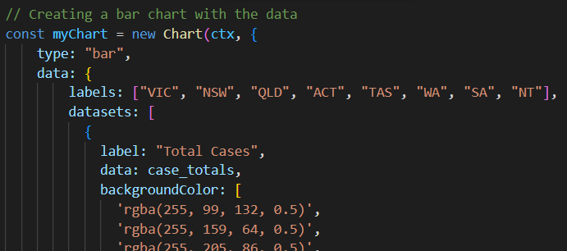
Creating the Charts - Bar Charts

Slide 11
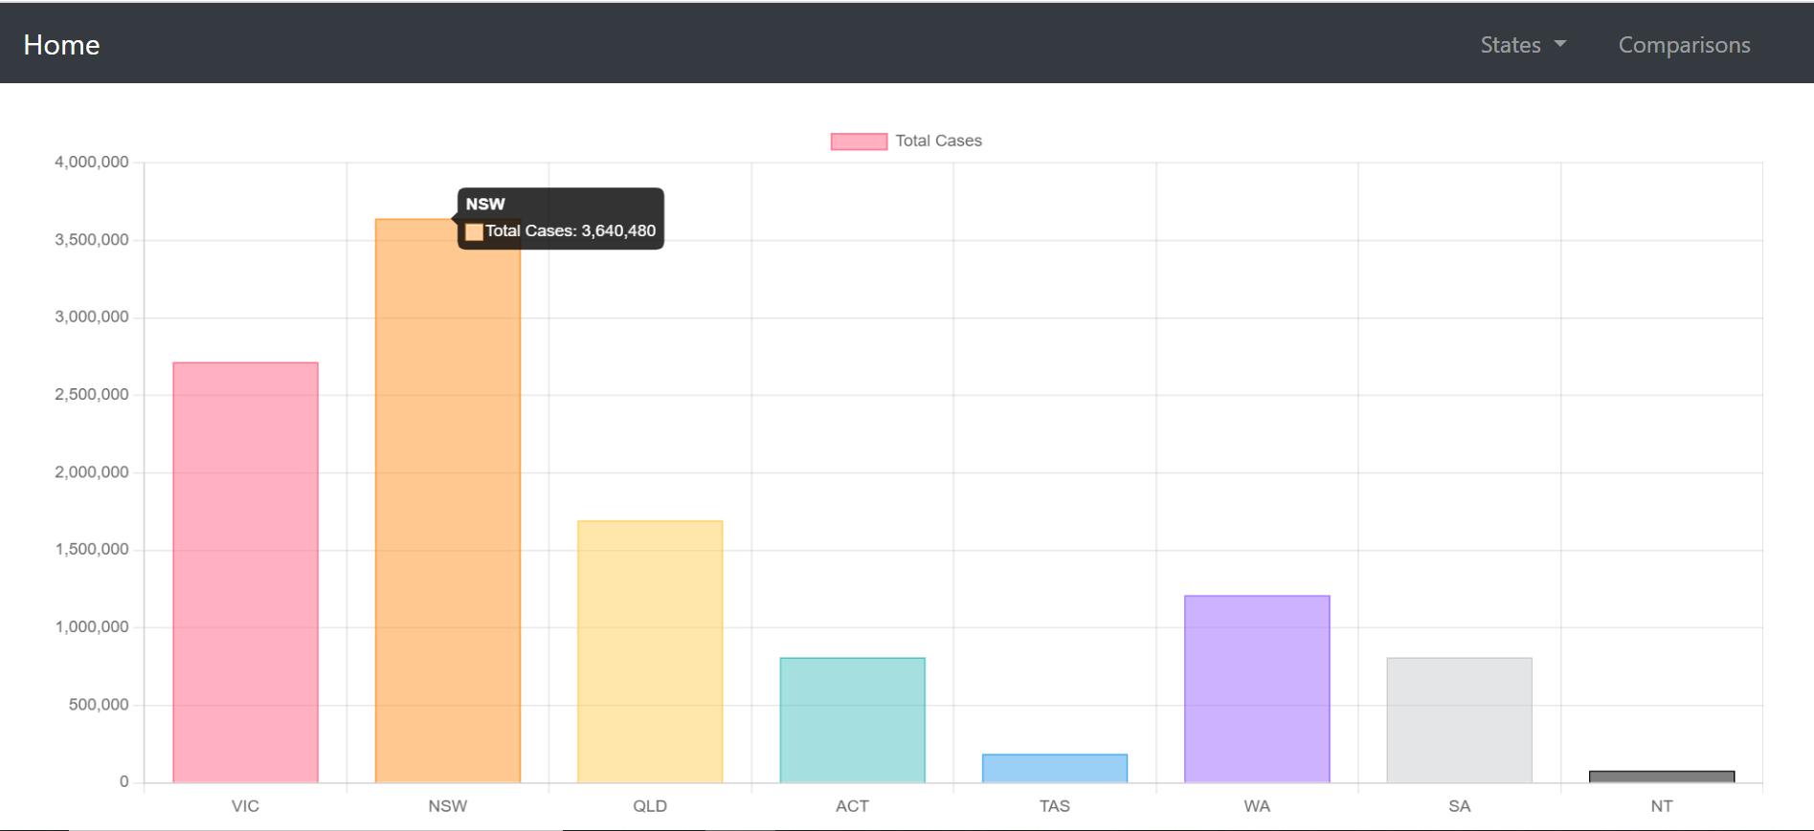
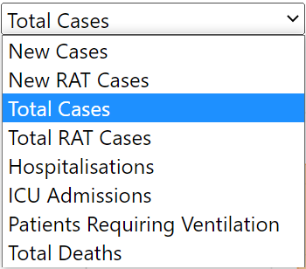
Comparisons Page

Slide 12

Demonstration

Slide 13


